Slide 1
EMPATIJA
IZDELEK SODOBNE UMETNOSTI
Anastasia Titova 1.D

Slide 2
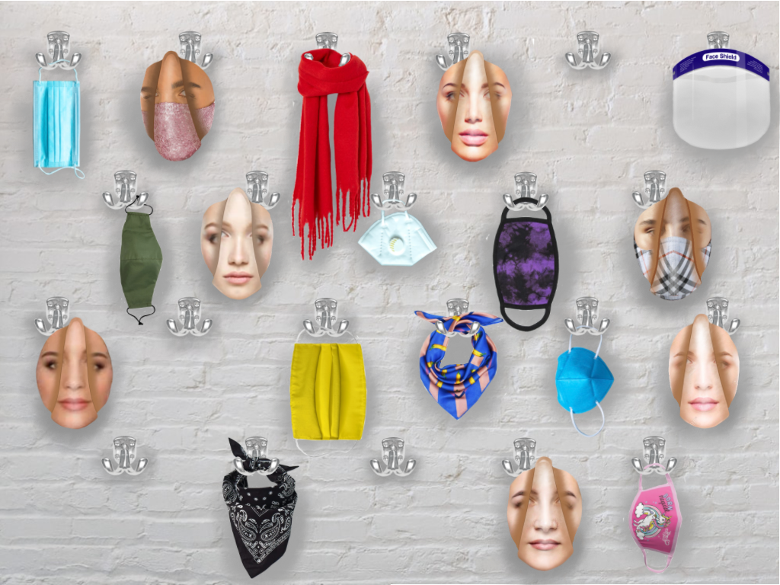

Slide 3
Sonet:
Although everyone says to stay the same,
we are changing ourselves from day to day,
you may say, what is written is a blame
but i'm not meaning it in a bad way.
Who you're gonna be is not in your hands,
it's others decision for todays face,
all of your character on them depends,
but what you are given you must embrace.
Maybe you do this to just understand,
look from another perspective to help,
or even obligate someones command
not to be being who uttered a yelp.
We must retain personality traits,
those we are born with, not ours mates.

Slide 4
Viri slik:
-Solid color face mask [internet]. [citirano 16. 04. 2021]. Dostopno na naslovu: https://cdn.shopify.com/s/files/1/2121/3325/products/olivegreenfacemaskwithfilterpockets_900x.jpg?v=1592584491
-Katie May Disco Ball Face Mask [internet]. [citirano 16. 04. 2021]. Dostopno na naslovu: https://www.hellomagazine.com/imagenes/fashion/celebrity-style/2020081395300/jennifer-lopez-pink-sequin-sparkly-face-mask-covering/0-456-527/jennifer-lopez-pink-sequin-face-mask-buy-z.jpg
-Bright Yellow Accordion Face Mask [internet]. [citirano 16. 04. 2021]. Dostopno na naslovu:
https://images.lookhuman.com/render/standard/RhPVDVc4PMCu6seCwg4uKzeUV3TTq9OL/maskcover-whi-z1-t-bright-yellow.jpg
-JoJo Siwa Kids Cloth Face Masks Cotton Pack of 3 Washable Reusable Non-Medical [internet]. [citirano 16. 04. 2021]. Dostopno na naslovu: https://i5.walmartimages.com/asr/6eb4a610-e249-4796-90e5-8fbe0e8298ee.dd35b75842eeefbeed07a84652c2fb29.jpeg
-Purple / Black Crystal Wash Tie-Dye Face Masks [internet]. [citirano 16. 04. 2021]. Dostopno na naslovu:
https://cdn.shopify.com/s/files/1/1690/3959/products/MASK-re1_620x.jpg?v=1598208429
-Which type of face mask is most effective against COVID [internet]. [citirano 16. 04. 2021]. Dostopno na naslovu: https://www.google.com/url?sa=i&url=https%3A%2F%2Fnews.llu.edu%2Fhealth-wellness%2Fwhich-type-of-face-mask-most-effective-against-covid-19&psig=AOvVaw09Qxb9kto7LFV73fte-vkl&ust=1620249725010000&source=images&cd=vfe&ved=0CA0QjhxqFwoTCPDO78q_sfACFQAAAAAdAAAAABAD.
-Cloth vs. Surgical Masks: Which Is Best? [internet]. [citirano 16. 04. 2021]. Dostopno na naslovu: https://www.google.com/url?sa=i&url=https%3A%2F%2Fwww.popularmechanics.com%2Fscience%2Fhealth%2Fa35290705%2Fwhich-face-mask-is-best-for-covid-protection%2F&psig=AOvVaw2xkf-zEzs50lwl8GFxoyjj&ust=1620249901952000&source=images&cd=vfe&ved=0CAIQjRxqFwoTCPCAhsy_sfACFQAAAAAdAAAAABAU
-BANANAS Silk Scarf [internet]. [citirano 16. 04. 2021]. Dostopno na naslovu: https://www.mynudesigner.com/2436-big_default_2x/bananas-silk-scarf.jpg
-Brushed-finish scarf [internet]. [citirano 16. 04. 2021]. Dostopno na naslovu: https://lp2.hm.com/hmgoepprod?set=quality%5B79%5D%2Csource%5B%2F51%2Fe2%2F51e2dcb84dc737adc2e04251babc8c8f56186abd.jpg%5D%2Corigin%5Bdam%5D%2Ccategory%5Bladies_accessories_scarves%5D%2Ctype%5BDESCRIPTIVESTILLLIFE%5D%2Cres%5Bm%5D%2Chmver%5B1%5D&call=url[file:/product/main]

Slide 5
Viri slik:
T-he Better Bandana with Filter [internet]. [citirano 16. 04. 2021]. Dostopno na naslovu: https://images-na.ssl-images-amazon.com/images/I/71K%2Ba95lolL._AC_UX385_.jpg
-Protective Isolation Face Shield, Model 57026 [internet]. [citirano 16. 04. 2021]. Dostopno na naslovu: https://www.deltatrak.com/assets/product-images/57026-1.jpg
-Burberry releases face mask with signature check pattern on antimicrobial fabric [internet]. [citirano 16. 04. 2021]. Dostopno na naslovu: https://static.dezeen.com/uploads/2020/08/burberry-face-masks-coronavirus-pandemic-fashion-design-ppe_dezeen_2364_sq.jpg
-Front Facing Woman Face Images [internet]. [citirano 16. 04. 2021]. Dostopno na naslovu: https://image.shutterstock.com/image-photo/front-portrait-woman-beauty-face-260nw-497756323.jpg
-Front view on beautiful female face with perfect skin [internet]. [citirano 16. 04. 2021]. Dostopno na naslovu: https://thumbs.dreamstime.com/b/front-view-beautiful-female-face-perfect-skin-front-view-beautiful-female-face-perfect-skin-over-white-background-143563838.jpg
-Beauty woman face [internet]. [citirano 16. 04. 2021]. Dostopno na naslovu: https://previews.123rf.com/images/subbotina/subbotina1510/subbotina151000020/46048941-beauty-woman-face-beautiful-spa-girl-with-perfect-clean-skin.jpg
-Face Template [internet]. [citirano 16. 04. 2021]. Dostopno na naslovu: https://encrypted-tbn0.gstatic.com/images?q=tbn:ANd9GcQ4JEyWKKyou5-67dX9QOs1h5PM6j5gM8XtRQ&usqp=CAU
-Woman Face PNG Free Image [internet]. [citirano 16. 04. 2021]. Dostopno na naslovu: https://lh3.googleusercontent.com/proxy/I_Bc_krry6YlFI87T-V-bm1SMYSyal7Nr0mYEnEUvbAYqrXEb4-f_rAdK-BQg3-b_KWbyXDLjEl5g262obVXB8yjTY7_g2LauxnNYmbfvGWjJ2Tz14J2akZHCs9SqMLL
-500+ White Wall Pictures [internet]. [citirano 16. 04. 2021]. Dostopno na naslovu: https://images.unsplash.com/photo-1531685250784-7569952593d2?ixid=MnwxMjA3fDB8MHxzZWFyY2h8Mnx8d2hpdGUlMjB3YWxsfGVufDB8fDB8fA%3D%3D&ixlib=rb-1.2.1&w=1000&q=80gtEGJW_u5EzLPG7HY9
-CAST DOUBLE WALL HOOK [internet]. [citirano 16. 04. 2021]. Dostopno na naslovu: https://cdn.shopify.com/s/files/1/0174/2162/products/VDYKE_AND_DEAN_CAST_DOUBLE_WALL_COAT_HOOKS.png?v=1612805873

