Slide 1
Empatija
Taja Bratovž, 1.g

Slide 2
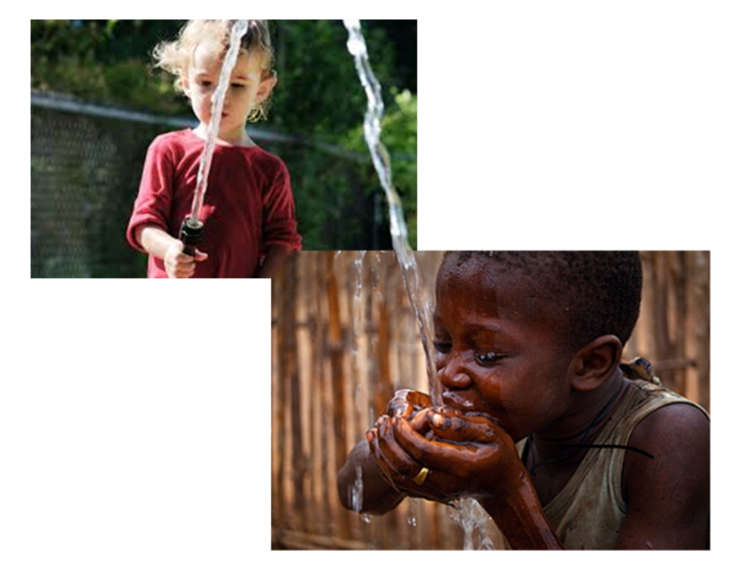

Slide 8
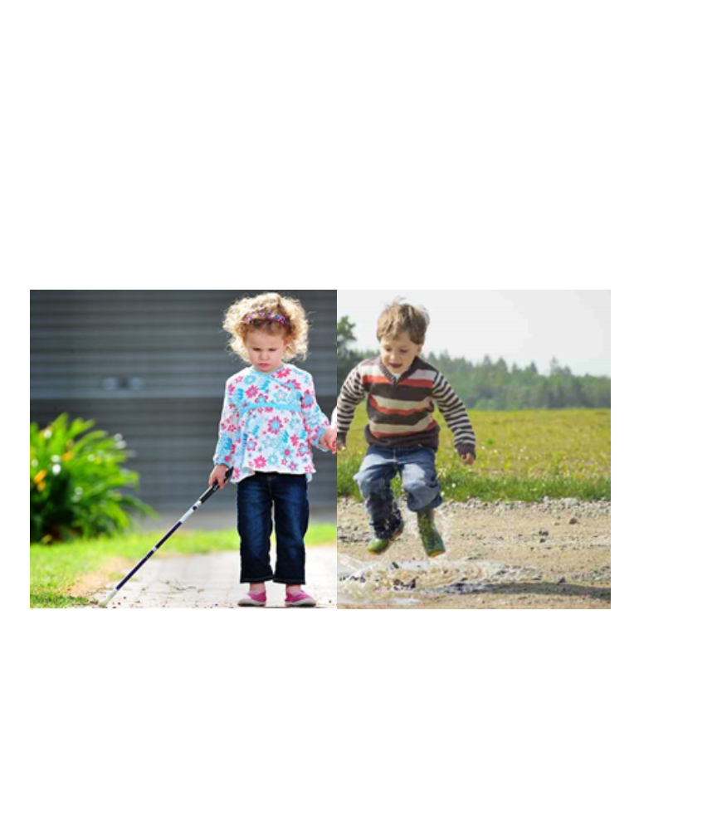

Slide 9
Viri:
&sxsrf=ALeKk01lxtIL4zs2bHEjbS42NIbp7z9tXA:1620318098430&source=lnms&tbm=isch&sa=X&ved=2ahUKEwiB57elu7XwAhUDy6QKHalKDcsQ_AUoAXoECAEQAw&biw=1366&bih=598#imgrc=73WgIxhdwuWU7M
https://www.google.com/search?q=parent+lifting+baby&client=firefox-b-d&sxsrf=ALeKk01CWM_YcNxnJPu8qCOPxnLxepC9xA:1620320318601&source=lnms&tbm=isch&sa=X&ved=2ahUKEwjDt4zIw7XwAhXB8qQKHfYnAHoQ_AUoAXoECAEQAw&biw=1366&bih=598#imgrc=czP7mbuGqqqYhM&imgdii=wfC0imhzdrVqvM
https://www.google.com/imgres?imgurl=https%3A%2F%2Fi.pinimg.com%2F474x%2F59%2Ff8%2Ffb%2F59f8fb80c09ec00704c7550aeecb6a8d.jpg&imgrefurl=https%3A%2F%2Fwww.pinterest.com%2Fpin%2F430445676888736017%2F&tbnid=nTjYjiSyp5zHmM&vet=10CBEQxiAoC2oXChMIiLXbyqi18AIVAAAAAB0AAAAAEA4..i&docid=40rM9tGcARj-OM&w=451&h=500&itg=1&q=kid%20without%20leg&client=firefox-b-d&ved=0CBEQxiAoC2oXChMIiLXbyqi18AIVAAAAAB0AAAAAEA4
https://www.google.com/search?q=poor+children+life&client=firefox-b-d&source=lnms&tbm=isch&sa=X&ved=2ahUKEwjJ3uP8v7PwAhVLuqQKHfyNAS8Q_AUoAXoECAEQAw&biw=1366&bih=598#imgrc=49TOSkS_NKZchM&imgdii=qfgUkYVeLjkXDM
https://www.google.com/search?q=poor+children+life&client=firefox-b-d&source=lnms&tbm=isch&sa=X&ved=2ahUKEwiT0dSHwbPwAhUpwQIHHZ9OAnMQ_AUoAXoECAEQAw&biw=1366&bih=598#imgrc=MCSbfMTcRiEopM
https://www.google.com/search?q=children+cycling+panorama&tbm=isch&ved=2ahUKEwig3eHSwrPwAhVSg6QKHTUpCi0Q2-cCegQIABAA&oq=children+cycling+panorama&gs_lcp=CgNpbWcQAzoECAAQAzoCCAA6BQgAELEDOggIABCxAxCDAToECAAQQzoECAAQEzoICAAQBRAeEBM6BggAEB4QEzoGCAAQCBAeOggIABAIEB4QE1Dk2ANY3LMEYMi0BGgLcAB4AIAB-QGIAbYgkgEGOS4yNS4ymAEAoAEBqgELZ3dzLXdpei1pbWfAAQE&sclient=img&ei=2RKTYOCMA9KGkgW10qjoAg&bih=598&biw=1366&client=firefox-b-d#imgrc=YHskqhXKaiQ6PM
https://www.google.com/search?q=child+carrying+skis&tbm=isch&ved=2ahUKEwj-qvbpw7PwAhVEKewKHb-ODs8Q2-cCegQIABAA&oq=child+carrying+skis&gs_lcp=CgNpbWcQA1DP7ANYmfYDYN77A2gAcAB4AIABdogBggWSAQMwLjaYAQCgAQGqAQtnd3Mtd2l6LWltZ8ABAQ&sclient=img&ei=FhSTYP7HA8TSsAe_nbr4DA&bih=598&biw=1366&client=firefox-b-d#imgrc=FA7KZvPhJ1QL3M
https://www.google.com/search?q=poor+children+working&client=firefox-b-d&source=lnms&tbm=isch&sa=X&ved=2ahUKEwiskq-2xLPwAhVMC-wKHeCwAvEQ_AUoAXoECAEQAw&biw=1366&bih=598#imgrc=fzNswsBWObfrEM
https://www.google.com/search?q=children+laying+on+sofa&tbm=isch&ved=2ahUKEwjMiOTsvbPwAhXL6aQKHT7QDLYQ2-cCegQIABAA&oq=children+laying+on+sofa&gs_lcp=CgNpbWcQAzoGCAAQBxAeOggIABAIEAcQHlCe5wlYg_UJYID6CWgAcAB4AIABY4gBrAWSAQE5mAEAoAEBqgELZ3dzLXdpei1pbWfAAQE&sclient=img&ei=0Q2TYIzcGsvTkwW-oLOwCw&bih=598&biw=1366&client=firefox-b-d#imgrc=XGweuC4XuejUKM
https://www.google.com/search?q=poor+children+sleeping&client=firefox-b-d&source=lnms&tbm=isch&sa=X&ved=2ahUKEwjSjveevrPwAhWM3KQKHYMrAK4Q_AUoAXoECAEQAw&biw=1366&bih=598#imgrc=tW4NMawTNEchCM

